Slide 1
MULTI-CUT REBAR(11)
Advisor : Prof. K.C.Chang
Presenters : You-Ran Nai
Notes:
試試看暫停一下

Slide 2
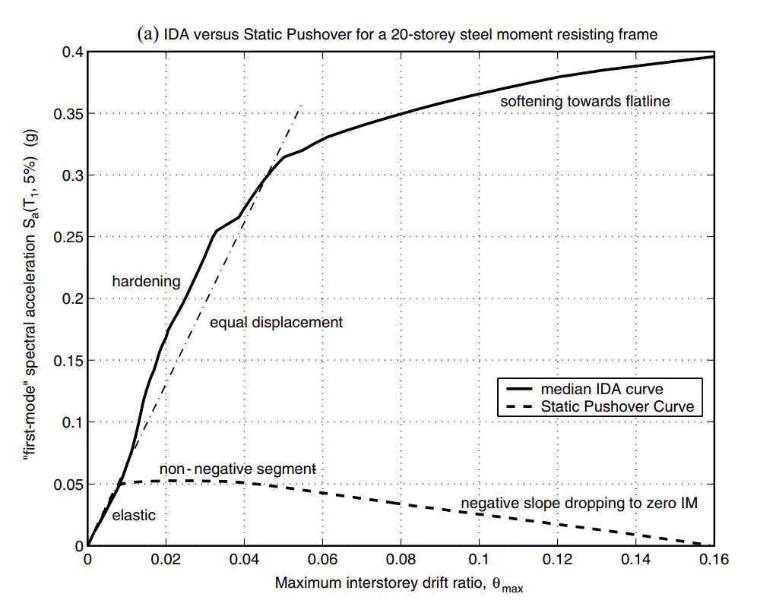
NON-LINEAR SPO
ELASTIC
➔
MATCH
NON-NEGATIVE
➔
EQUAL DISPLACEMENT
NEGATIVE
➔
SOFTENING

Slide 3
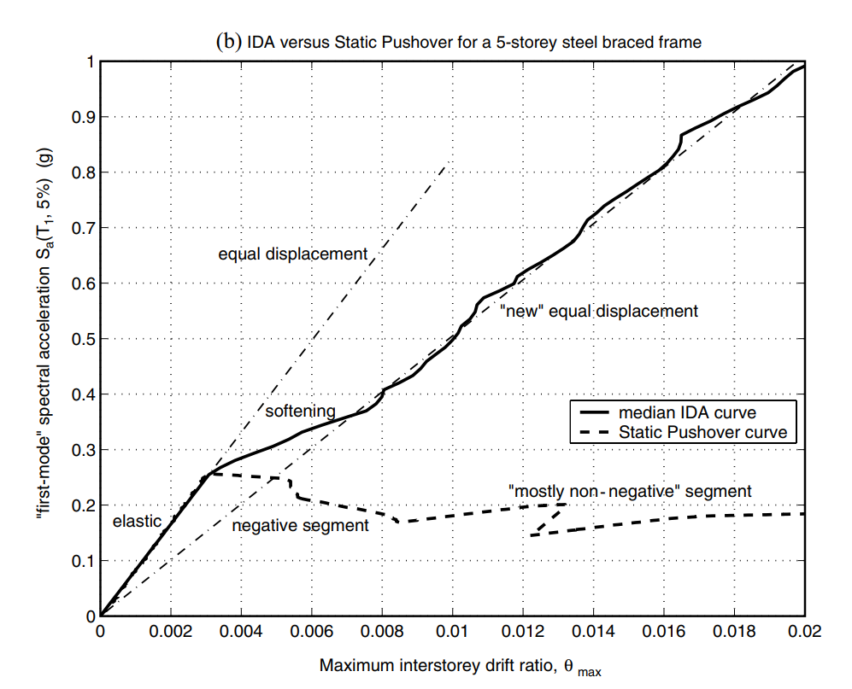
NON-LINEAR SPO
NEGATIVE => NON-NEGATIVE
NEW
EQUAL DISPLACEMENT
➔

Slide 4
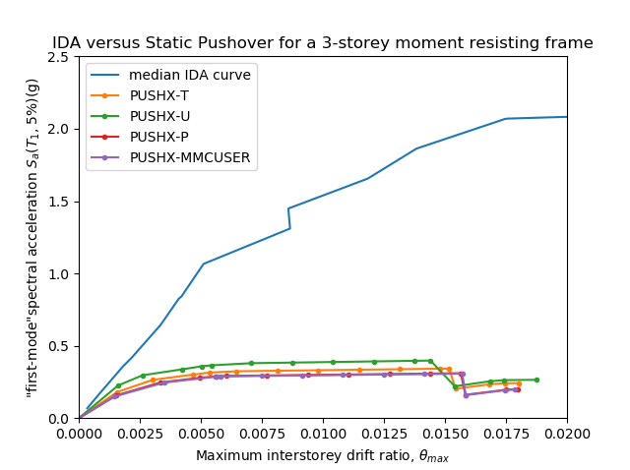
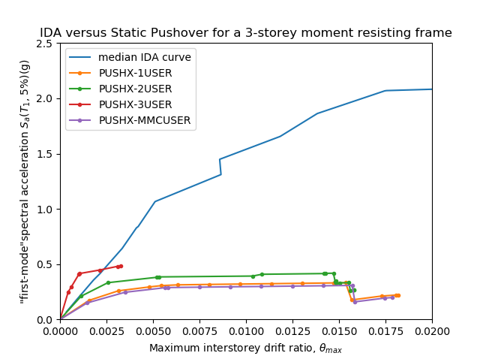
IDA vs Pushover

Slide 5
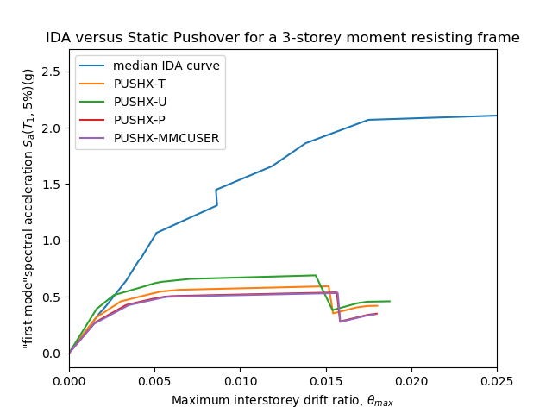
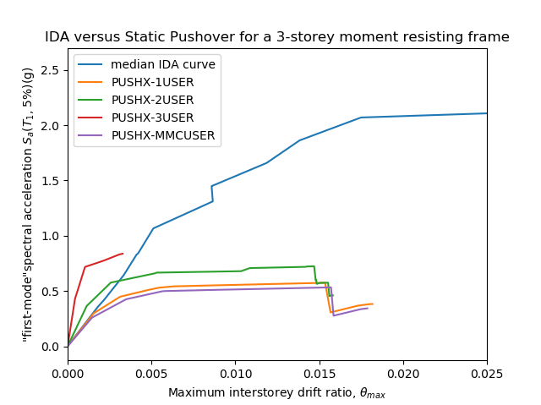
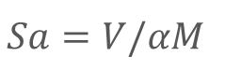
IDA vs Pushover
$$Sa=V/αM$$

Slide 6
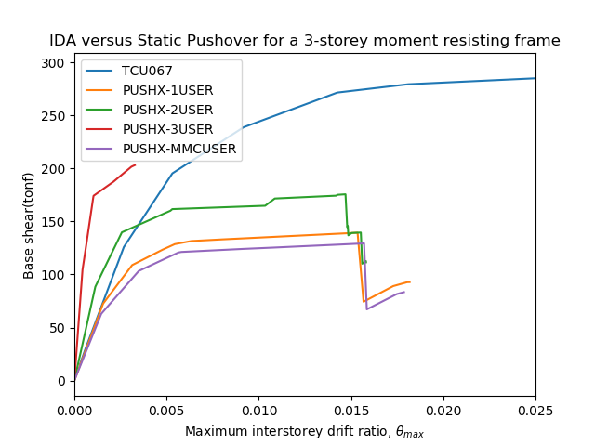

Slide 7
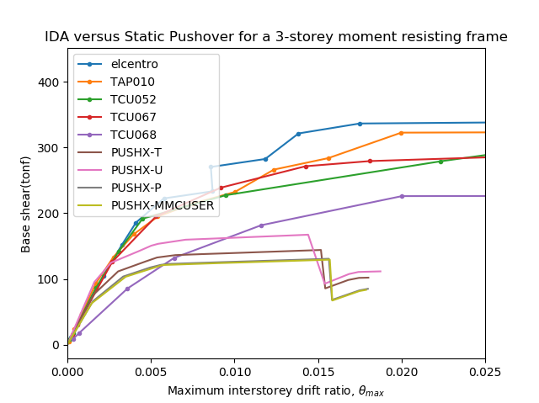
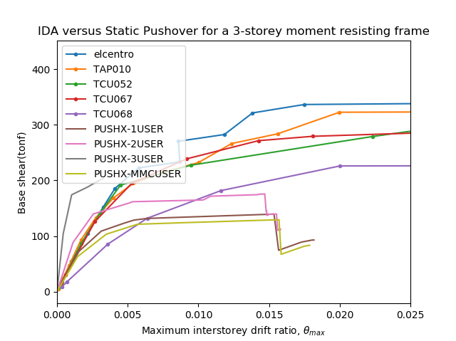

Slide 8
TAP010

Slide 9
TAP032

Slide 10
TAP052

Slide 11
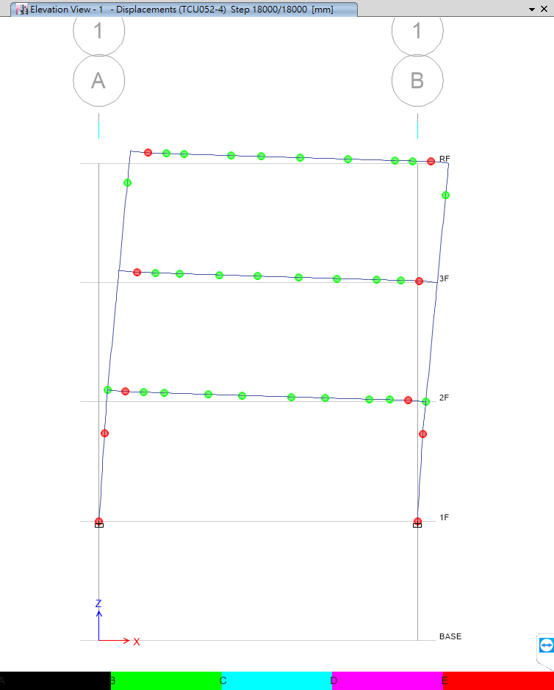
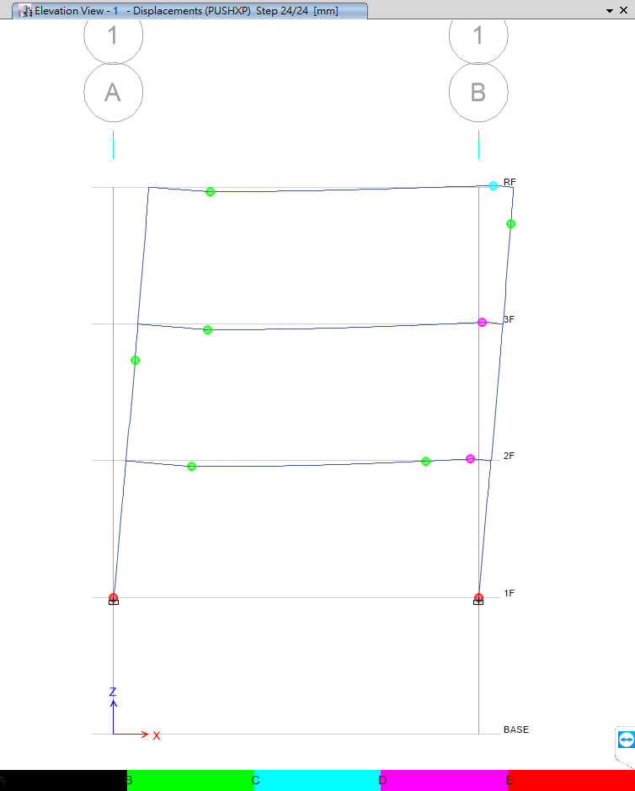
Problem
Time History
Pushover
No Middle Hinge

Slide 12
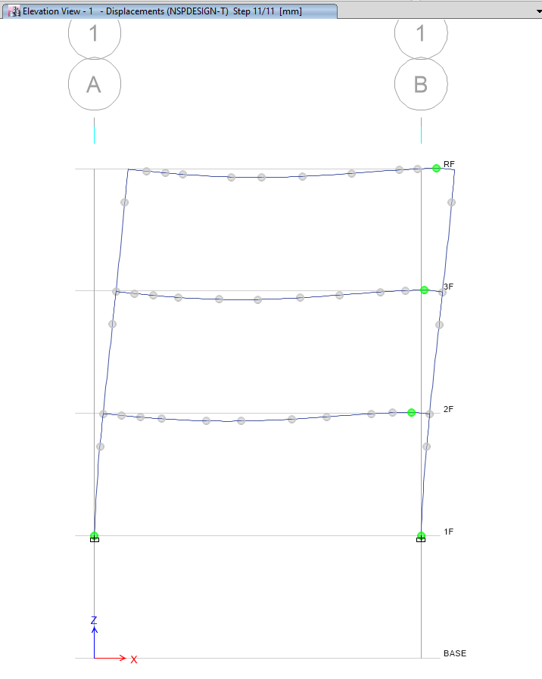
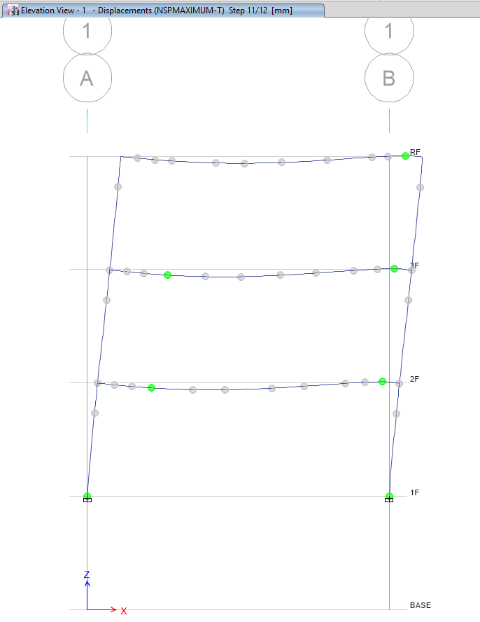
Pushover
Design
Maximum

Slide 13
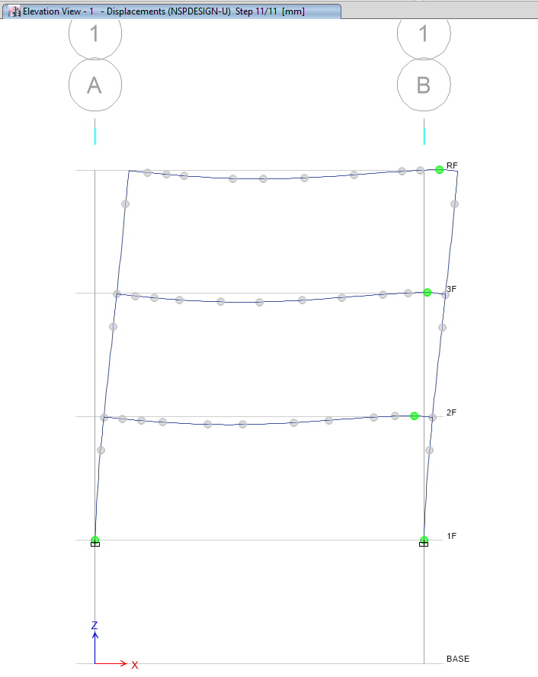
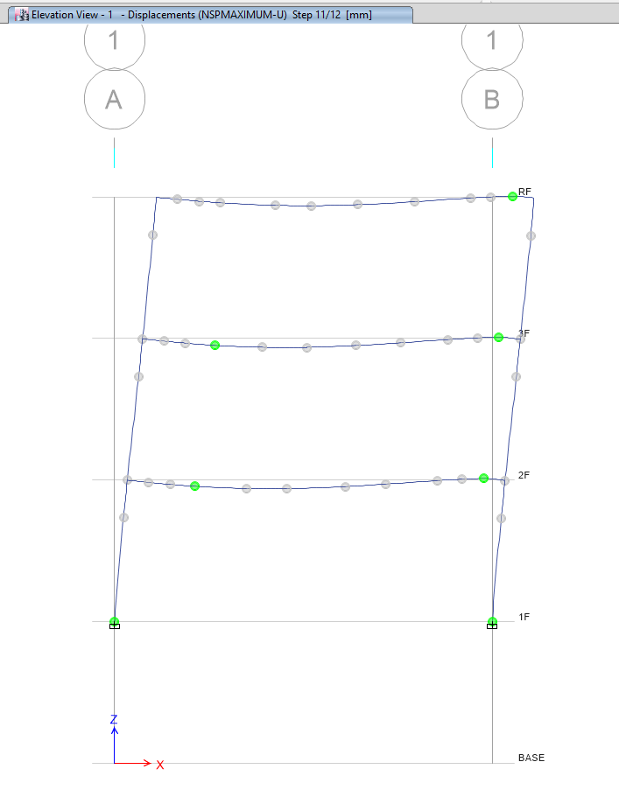

Slide 14
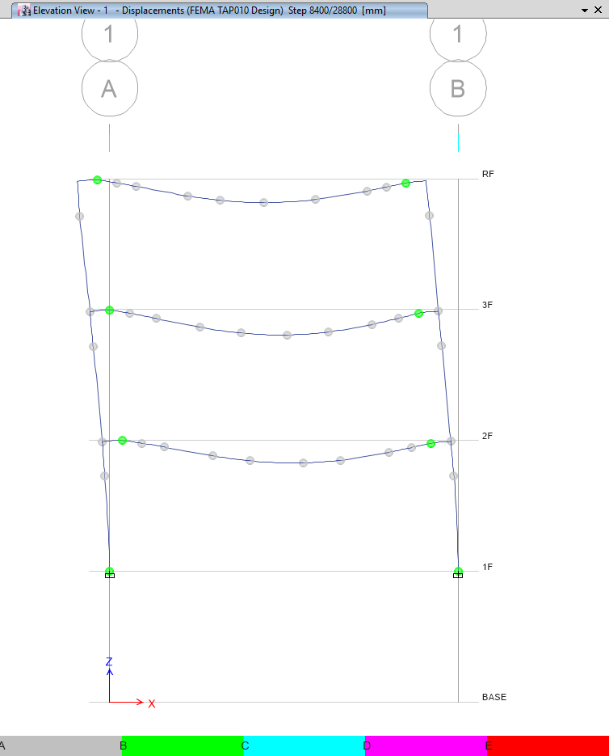
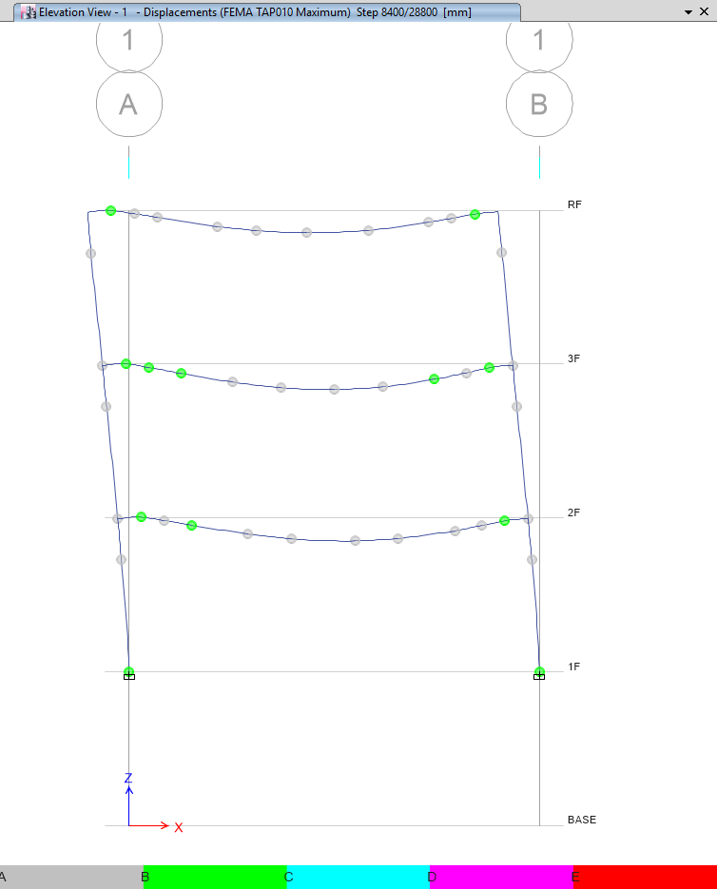
Artificial Time History - TAP010
Design
Maximum

Slide 15
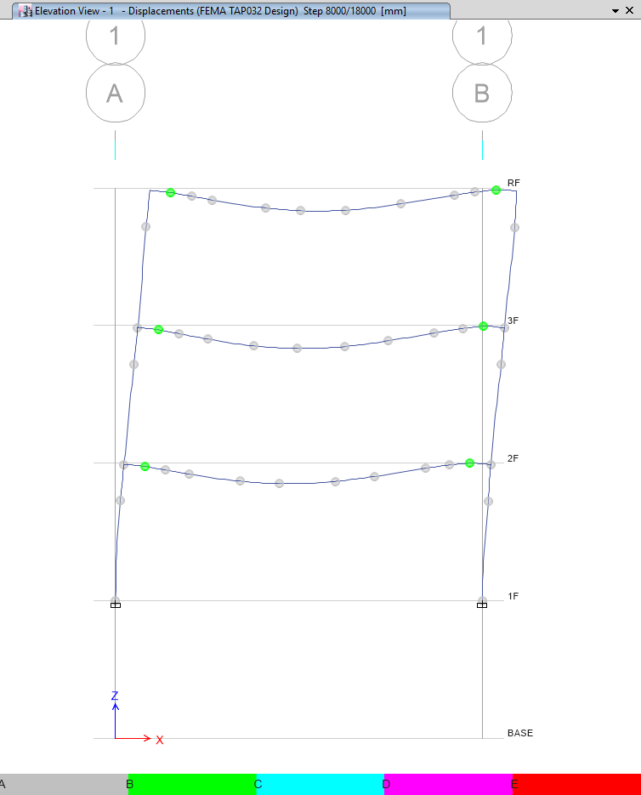
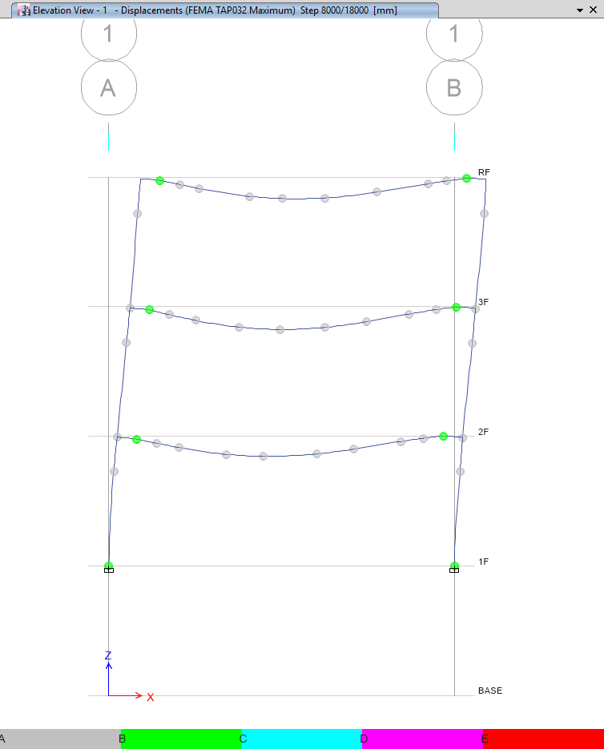

Slide 16
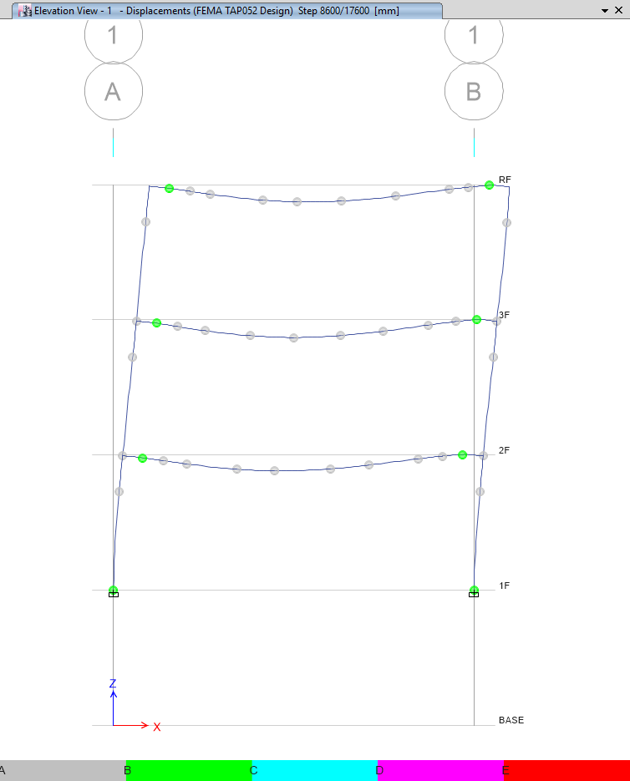
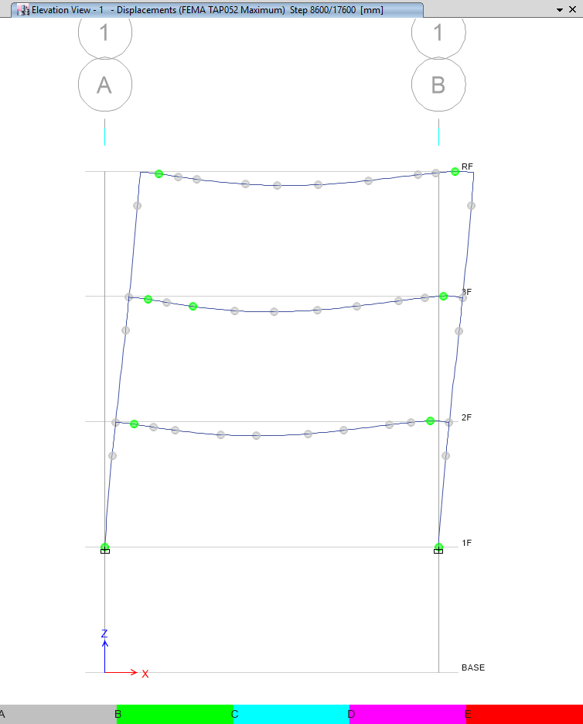

Slide 17
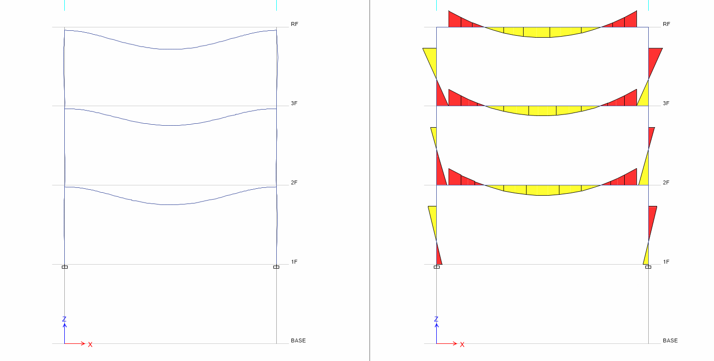
Pushover 0 Step
Hinge
Moment

Slide 18
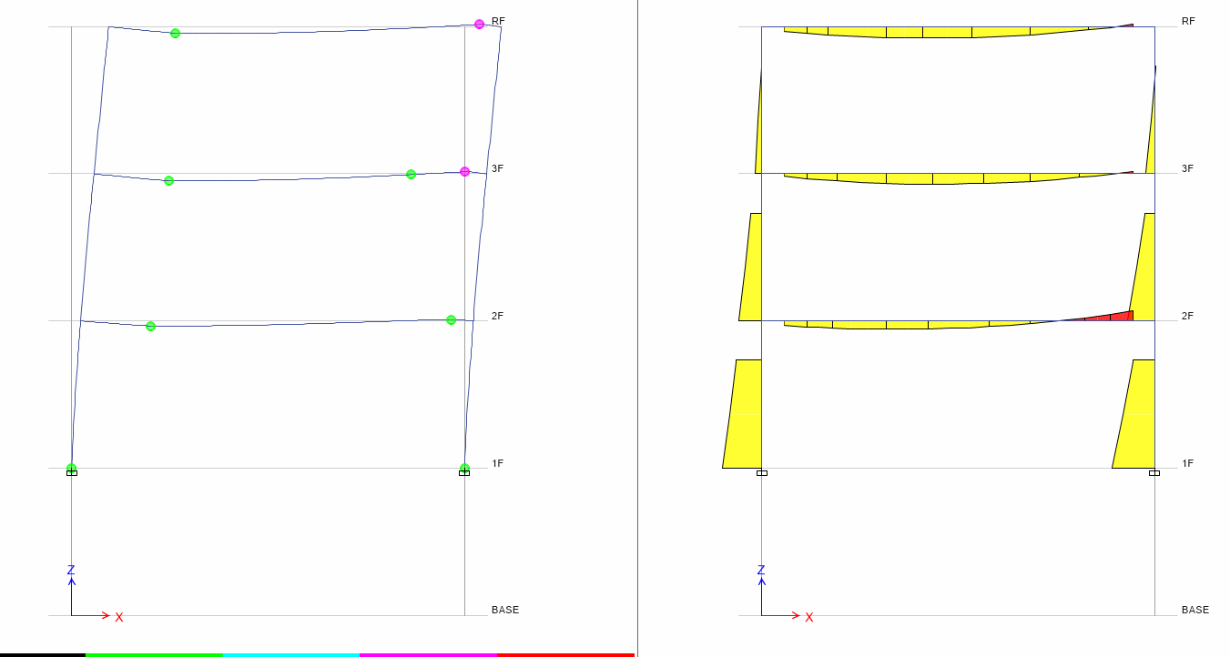
Pushover 13 Step
Hinge
Moment

Slide 19
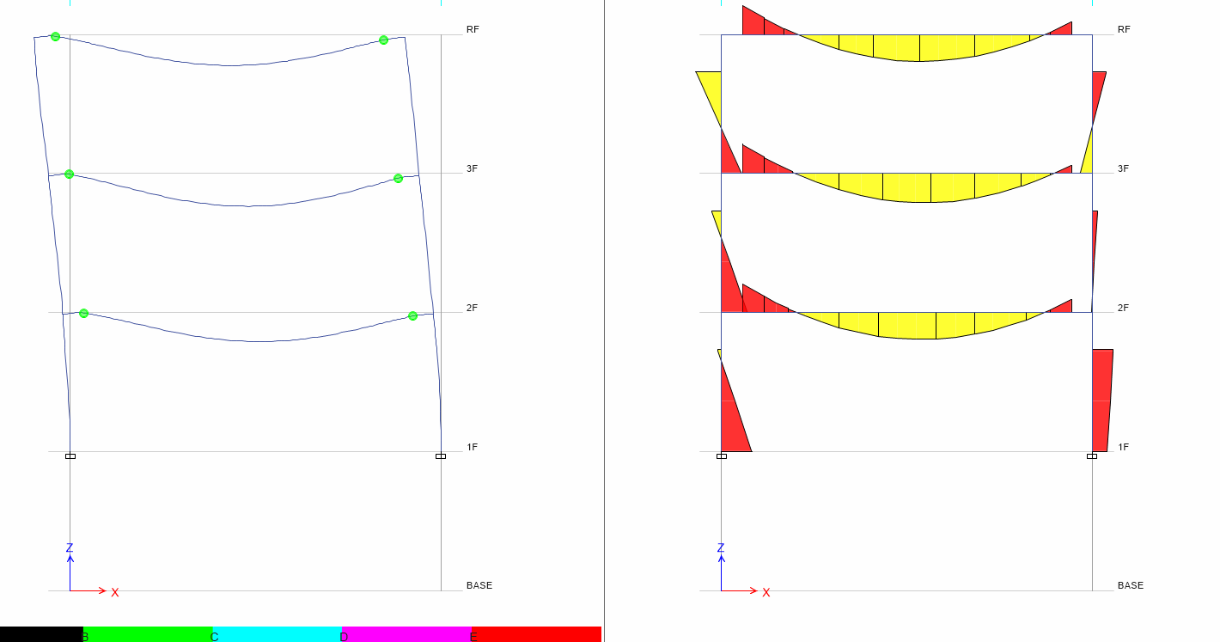
Time History 30s
Hinge
Moment

Slide 20
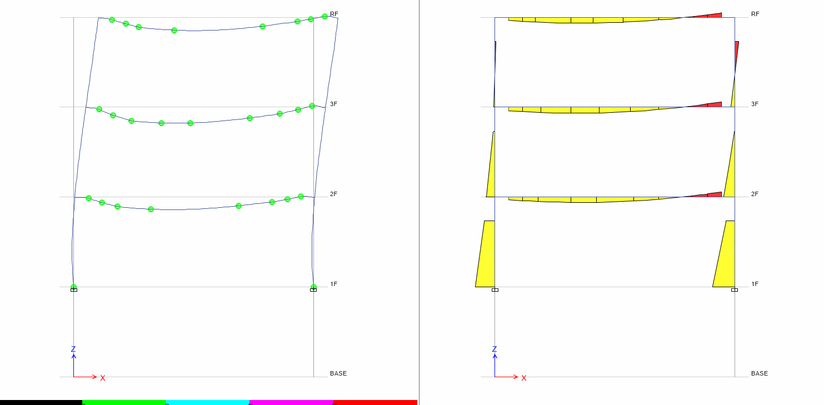
Time History 40s
Hinge
Moment

Slide 21
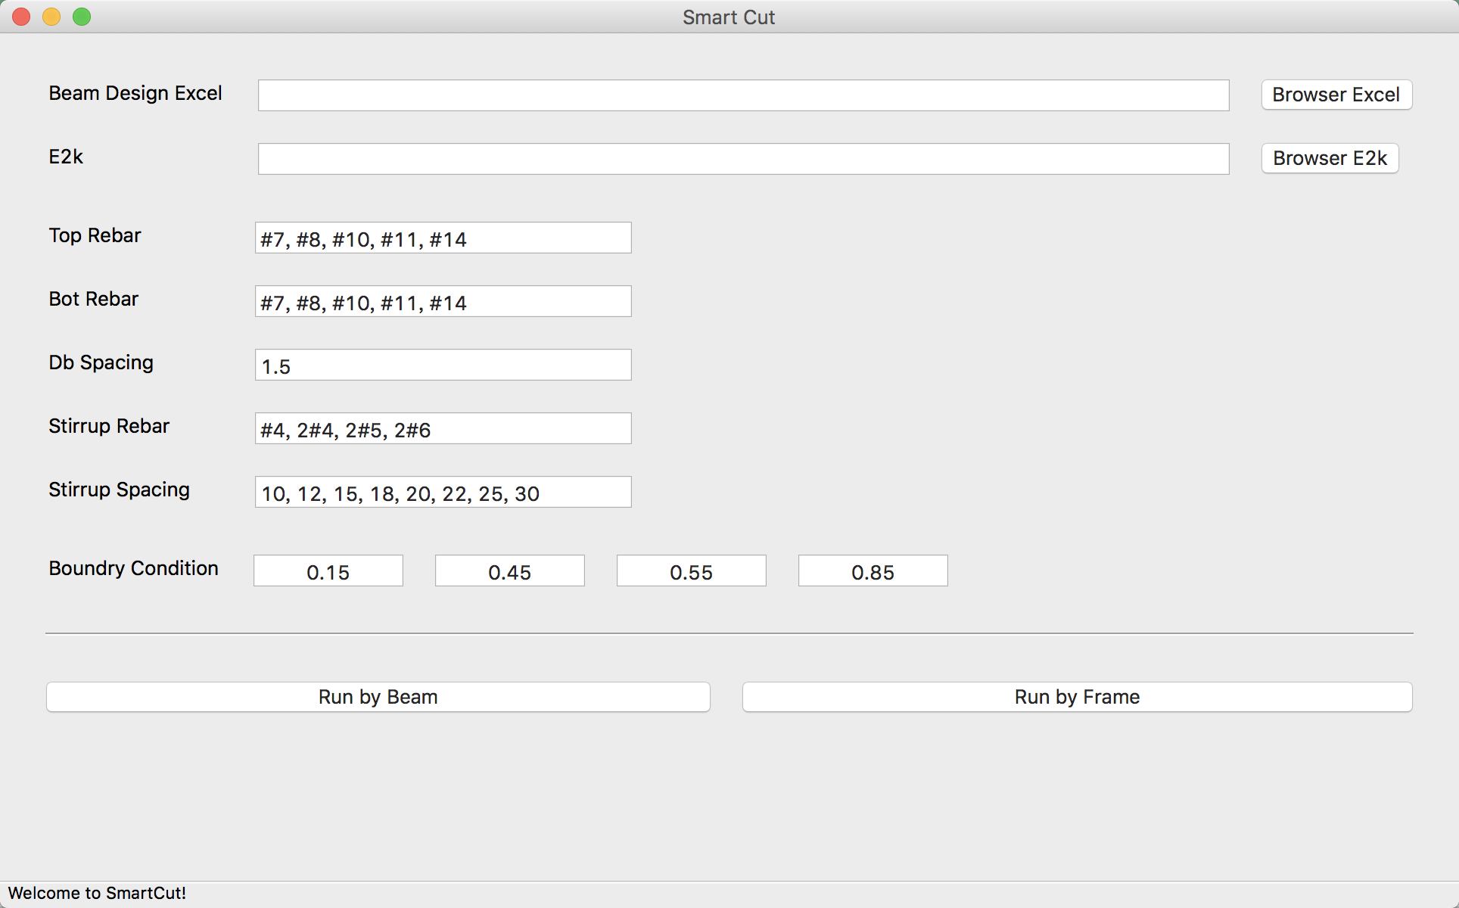
LinearCut
GUI

Slide 22
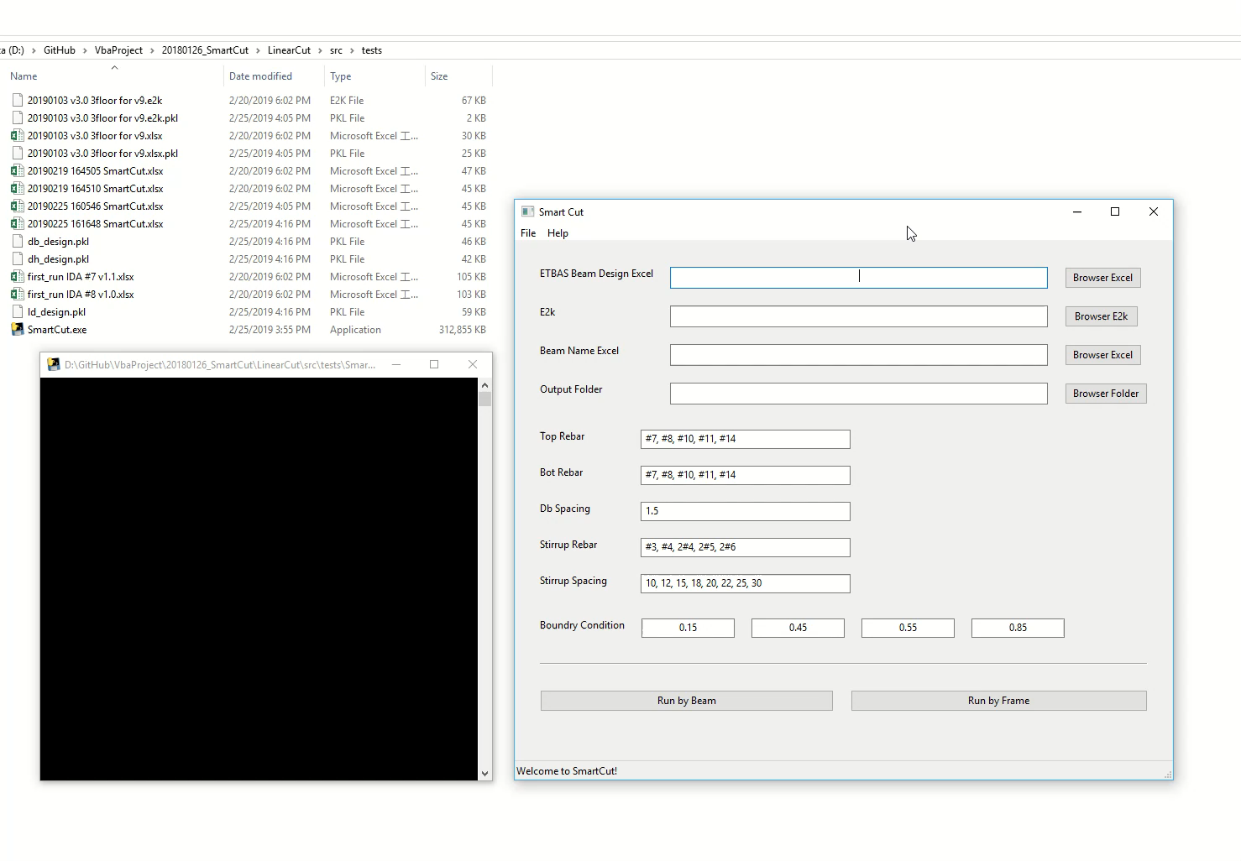

Slide 23
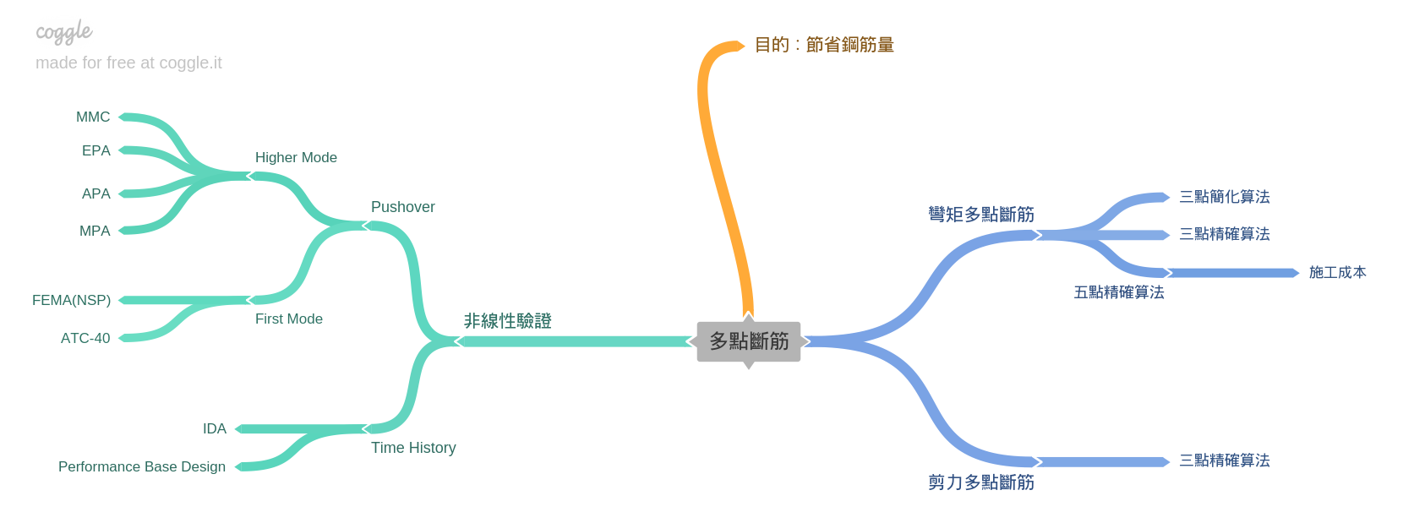
Roadmap
GUI
Nonlinear Hinge

